Slide 1
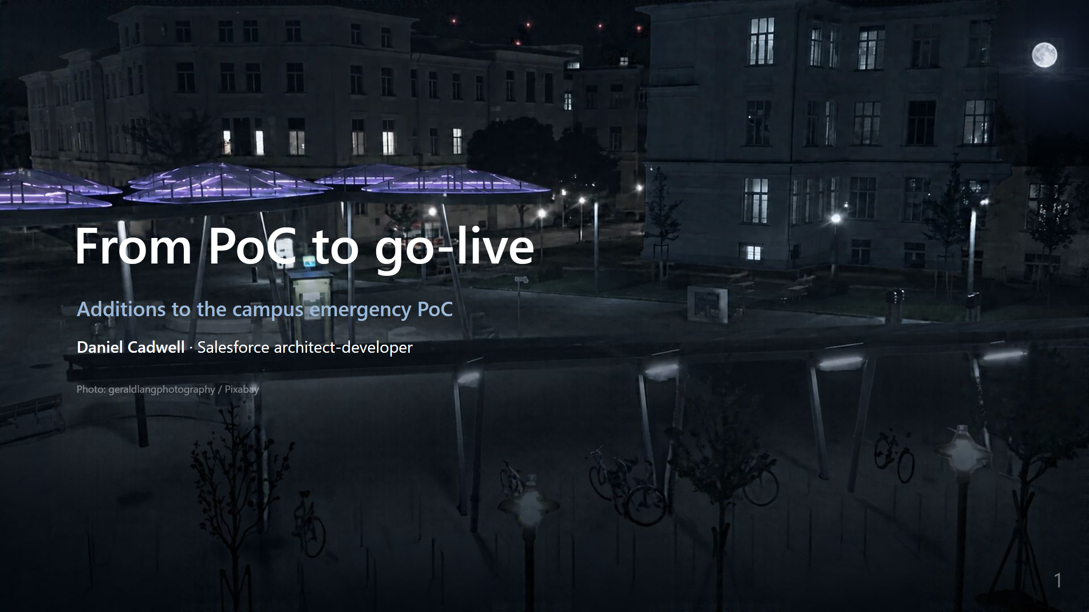
Notes:
_backgroundOpacity: 0.6
Speaker notes: frame this in the first sentence. "I haven't seen your PoC. This isn't a
replacement — it's the parts between where a PoC usually stops and where a campus can
actually run it. I built working versions of the hard ones so you can judge the skill,
not the slide."

Slide 2
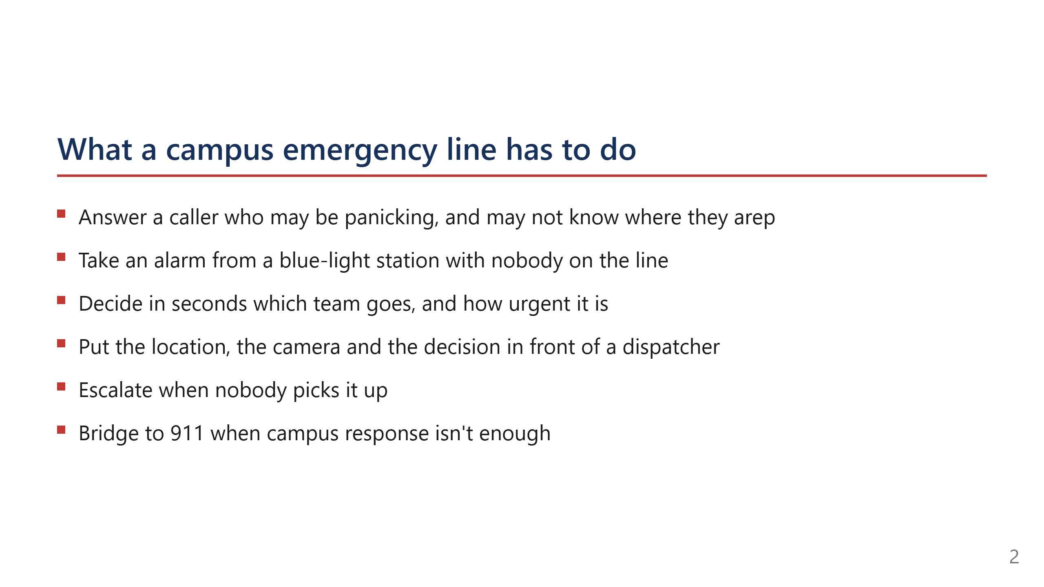
Notes:
Read the list, don't embellish. Every line is a requirement with a build consequence —
say that at the end. "Each of these is a feature, and each has a cost."

Slide 3
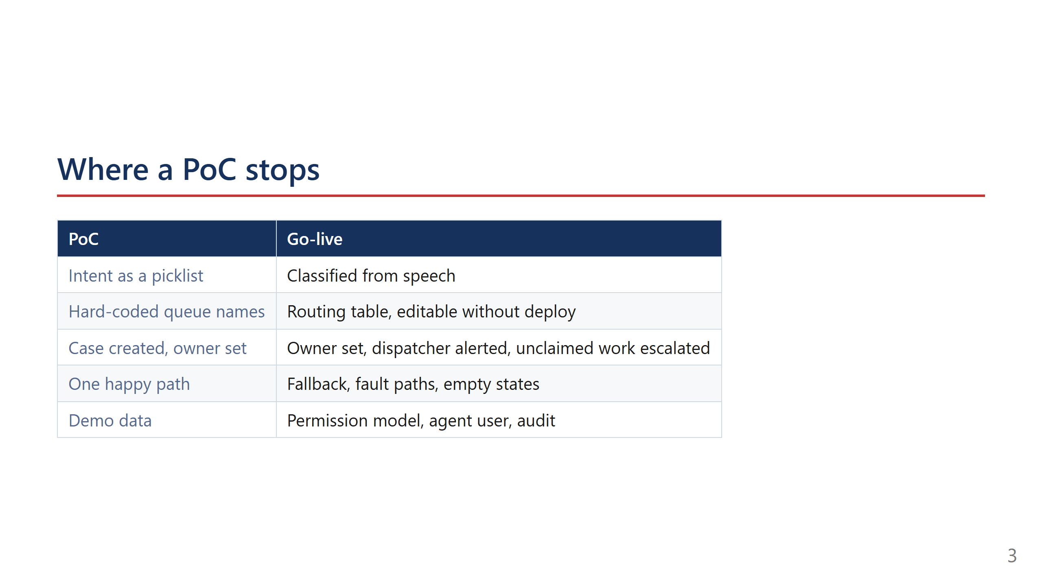
Notes:
This is the slide that earns the interview. Name which column their PoC is probably in,
and say you'd want to see it before committing to a plan. Don't hedge — they know.

Slide 4
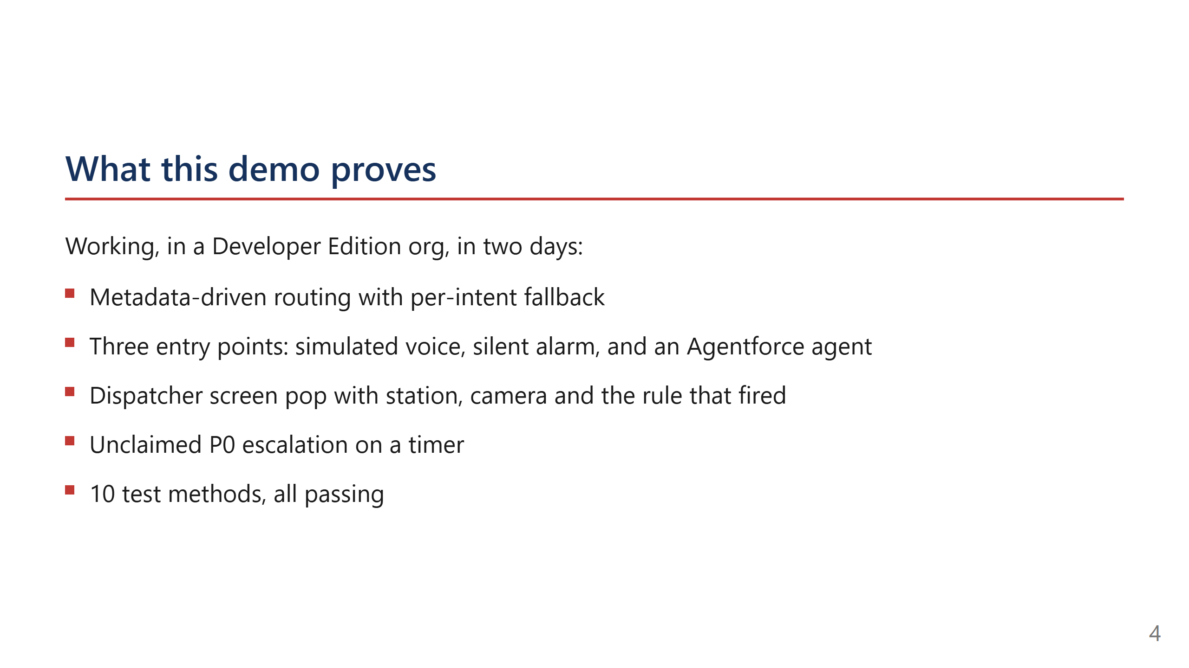
Notes:
Speaker notes: two days is the number that matters. It's the argument that adding to
their PoC is weeks, not quarters.

Slide 5
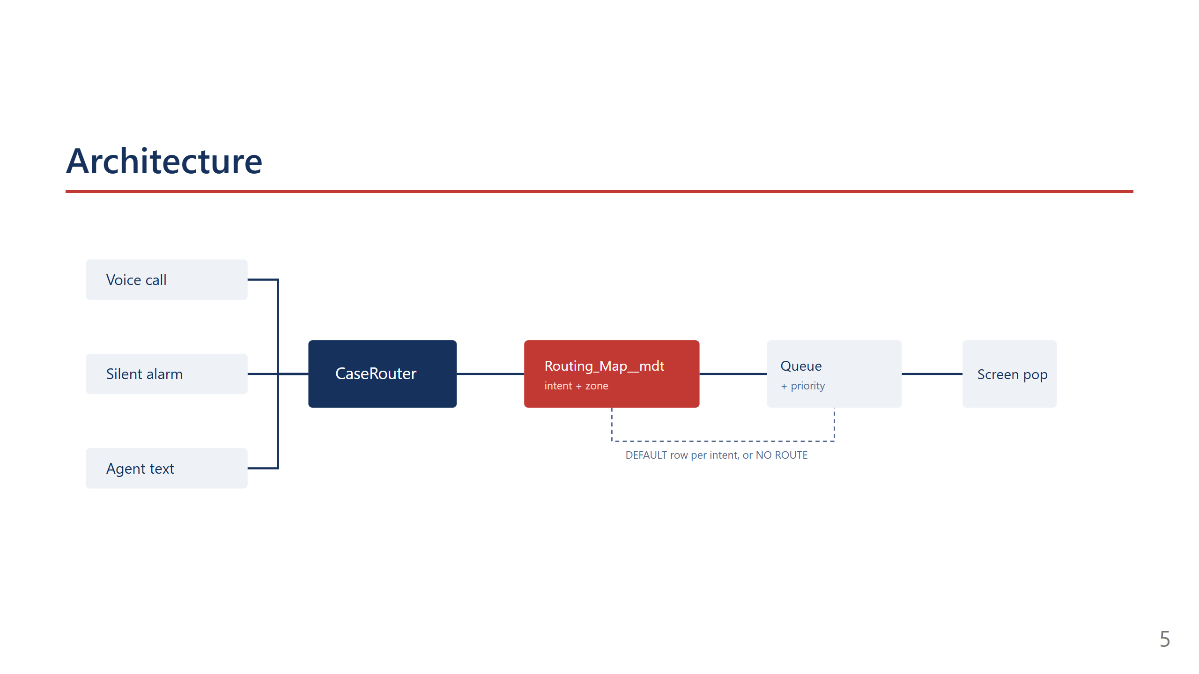
Notes:
Speaker notes: three doors, one router. The router is the only place that decides
anything, so behaviour is auditable in one place.

Slide 6
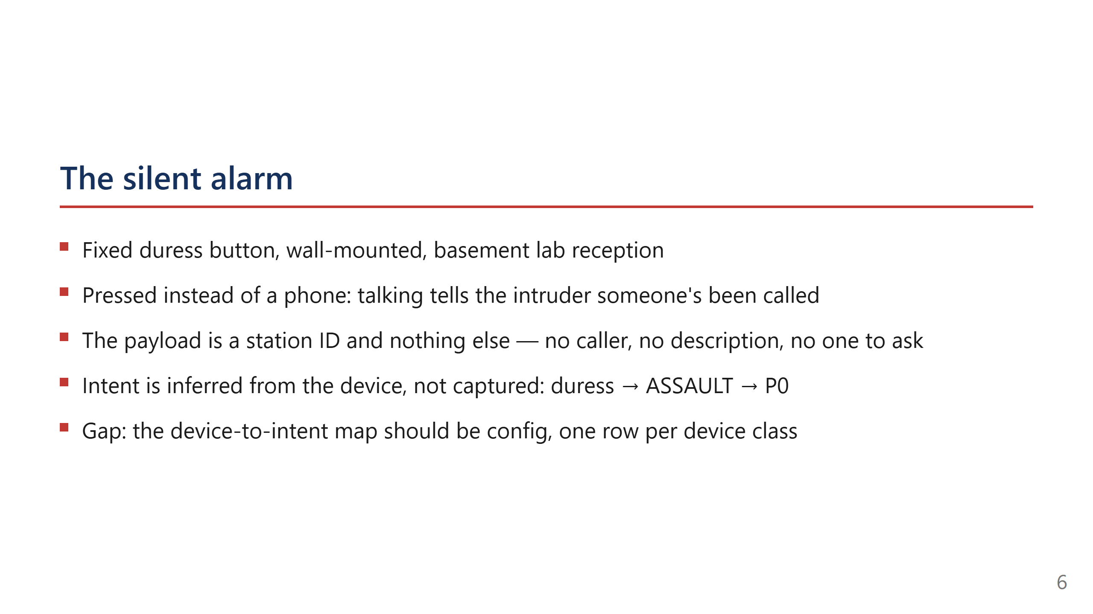
Notes:
Speaker notes: this is the slide that stops the "why is an alarm an assault"
question before it starts. A duress button exists for one situation — a person being
confronted now. Say that. Then say the honest part: the flow currently assumes duress
because there's only one silent device class in the build.

Slide 7
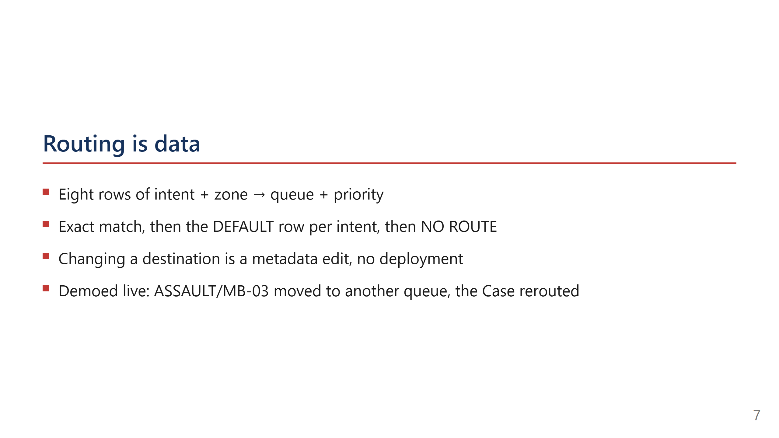
Notes:
This is the slide a facilities stakeholder cares about most. They can remap without a
release. Say that word — release — because it's the thing they're afraid of.

Slide 8
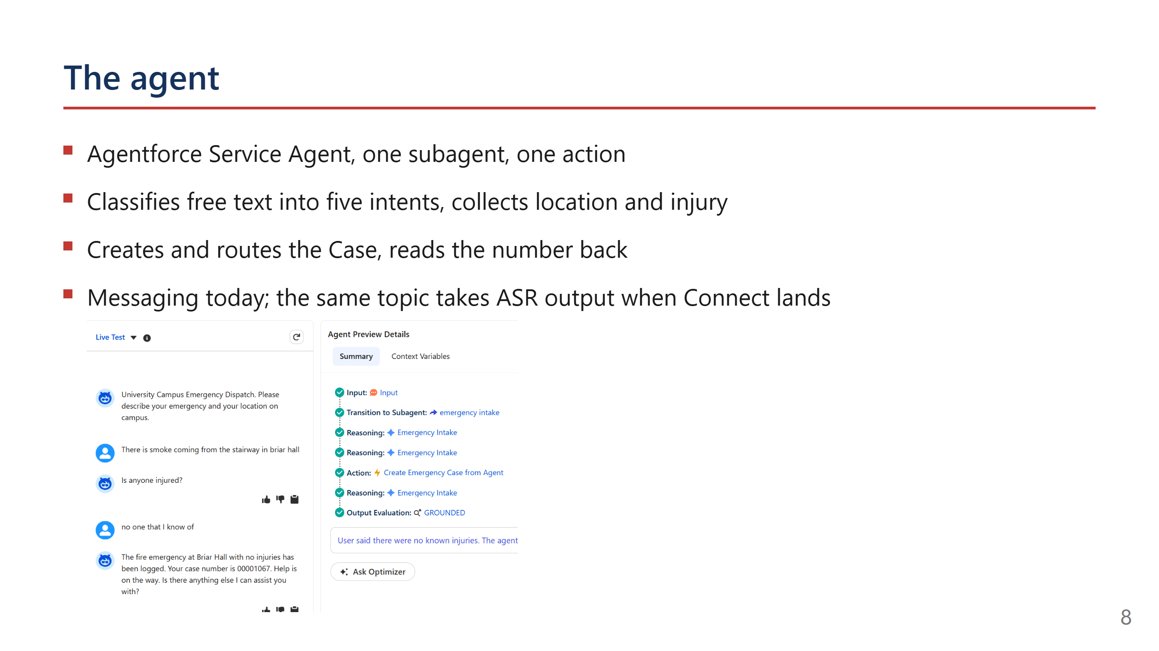
Notes:
Speaker notes: be explicit that it's messaging, not voice. The classifier is the piece
that makes the voice leg possible later.

Slide 9
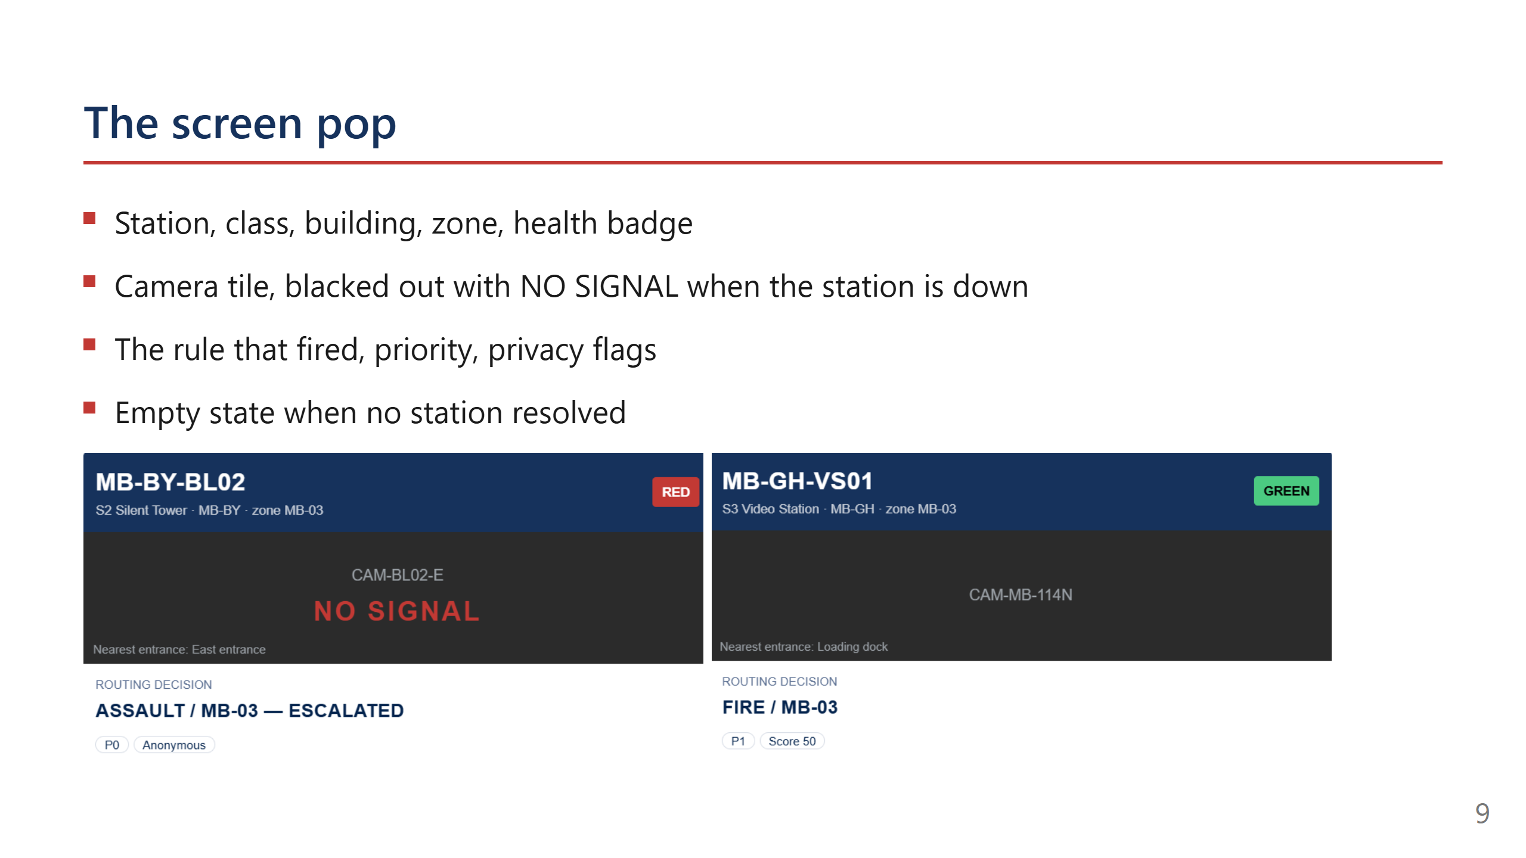
Notes:
A dead camera has to be visible at dispatch, not discovered later. The badge is the
feature. Point at the NO SIGNAL tile as you say it.

Slide 10
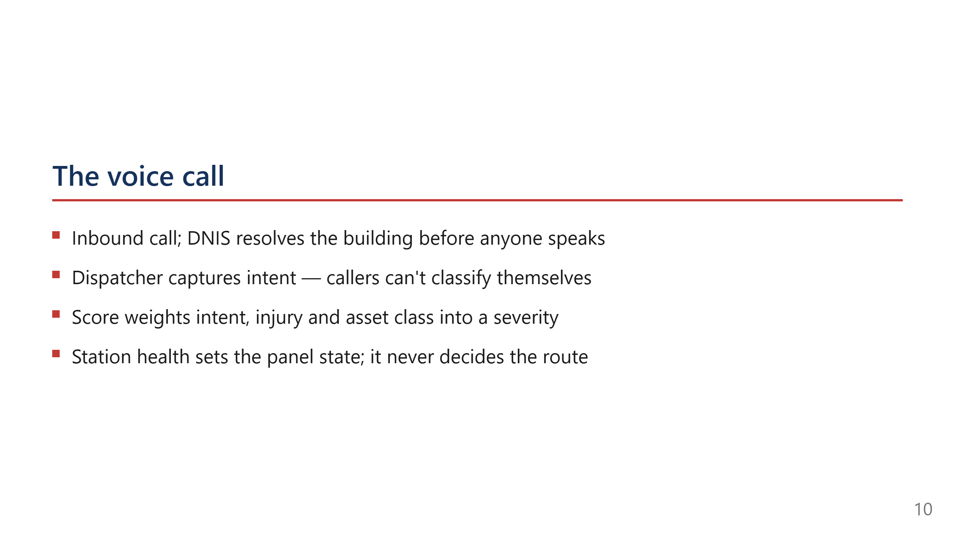
Notes:
Speaker notes: the contrast with the previous slide is the point. Silent has no
human, so intent is inferred. Voice has a human, so intent is captured. Same router,
same table, two very different information problems.

Slide 11
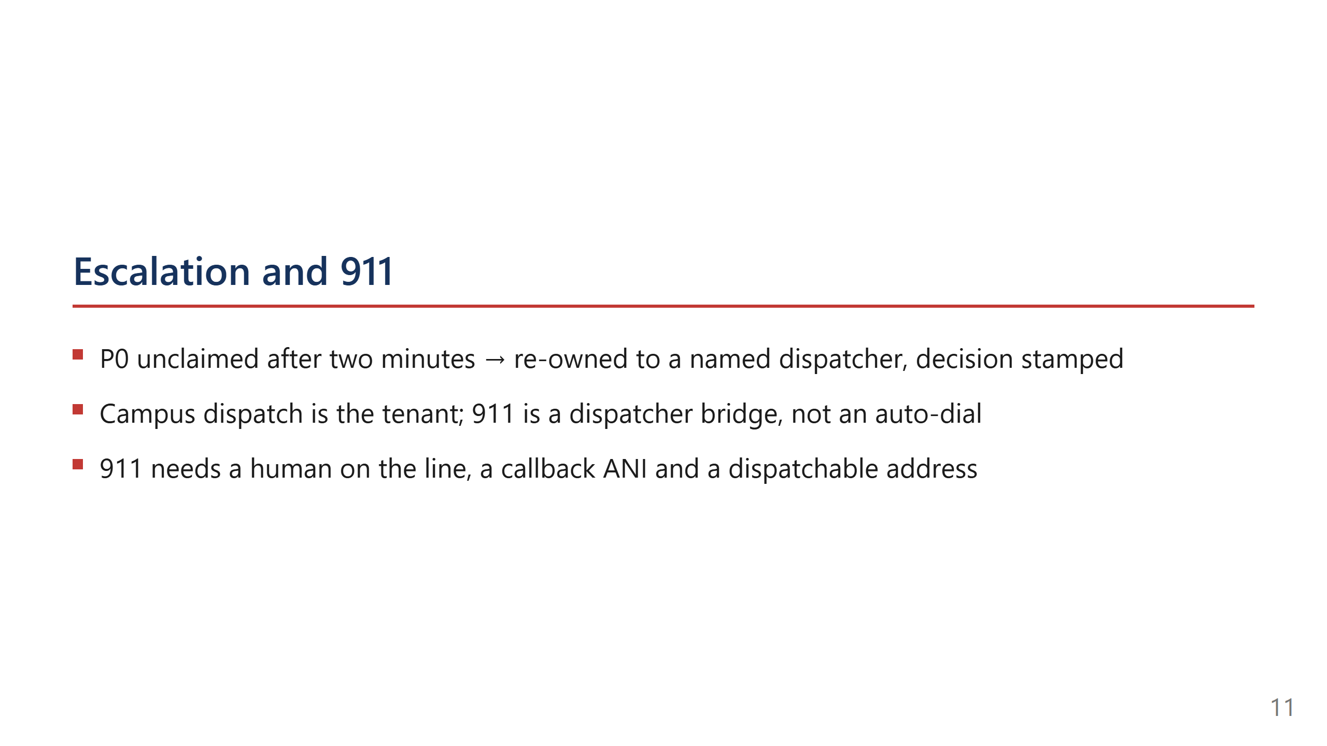
Notes:
Campus police reach a campus building faster than a PSAP and hold the keys and the
cameras. But campus-first must never become campus-only. The 911 bridge is a dispatcher
action on a live call, not a queue branch.

Slide 12
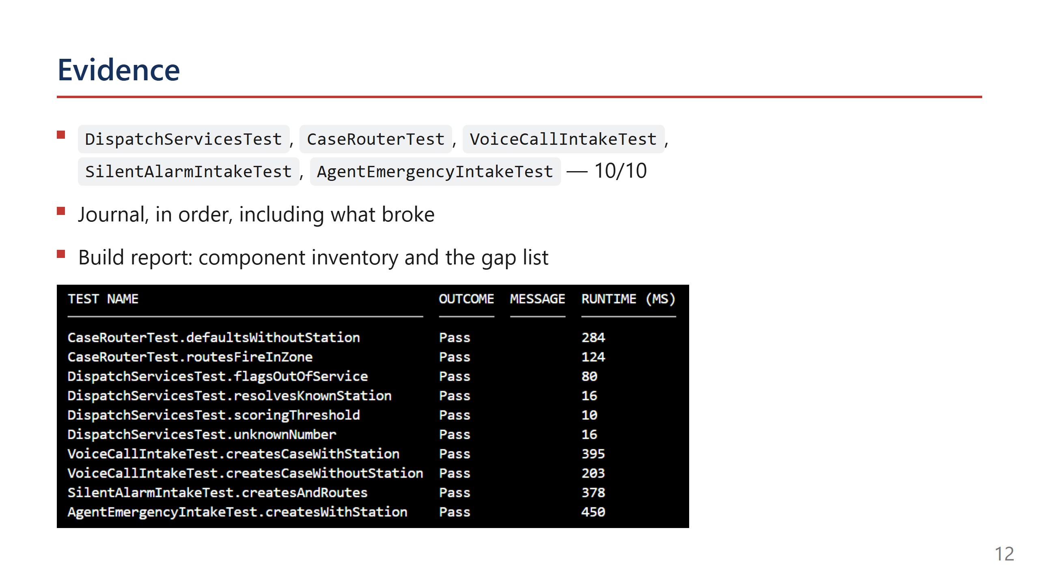
Notes:
Offer the repo here. Point at the journal specifically — it shows how you work when it
goes wrong, which is the actual hire. Then stop talking and let them read.

Slide 13
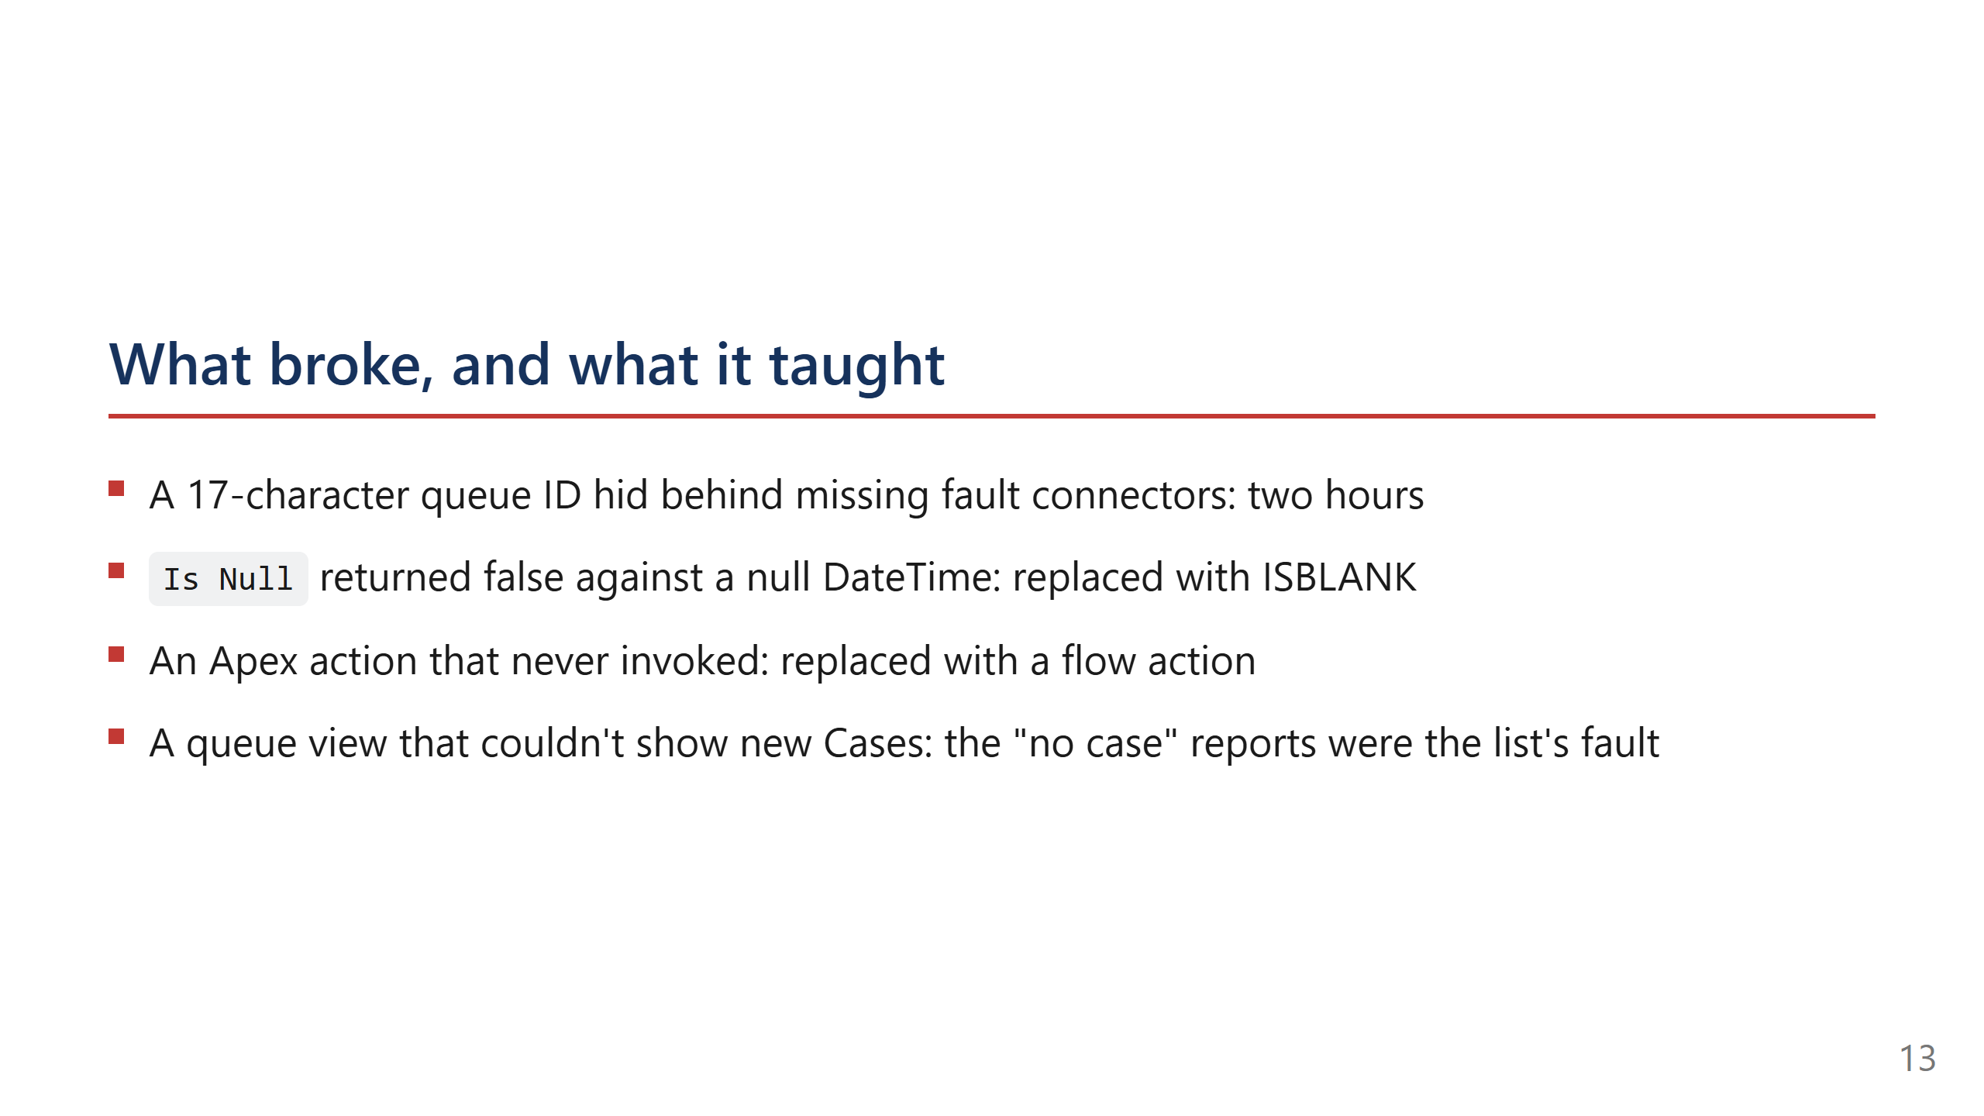
Notes:
Don't apologise. Each one names a lesson: fault connectors on every DML element, never
hand-type an ID, verify the instrument before trusting it. Two hours is the honest
number and it lands better than a round one.

Slide 14
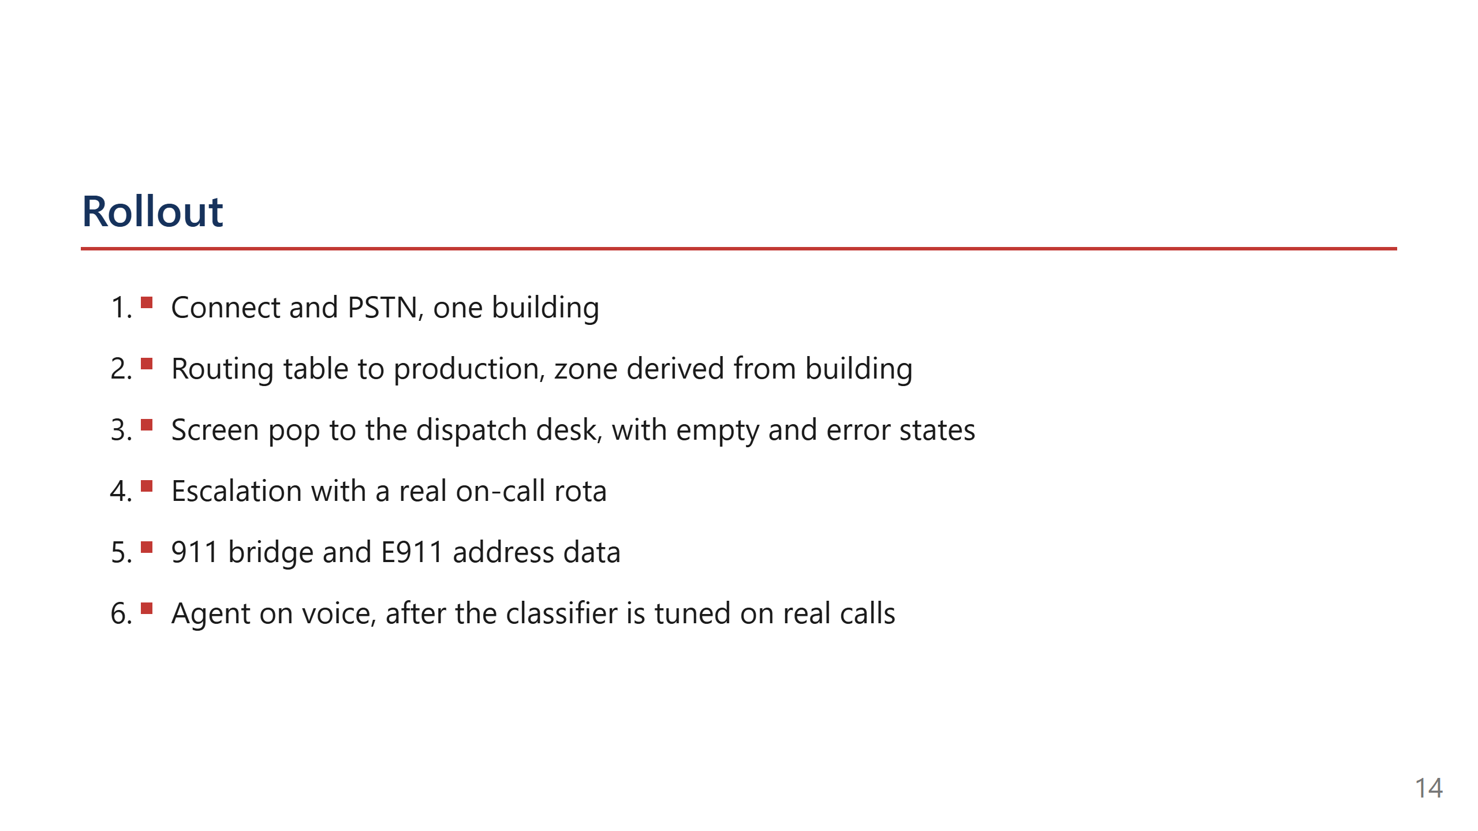
Notes:
One building first. The table and the pop are the value; telephony is procurement. Say
that order out loud — it shows you know which parts are yours to control.

Slide 15
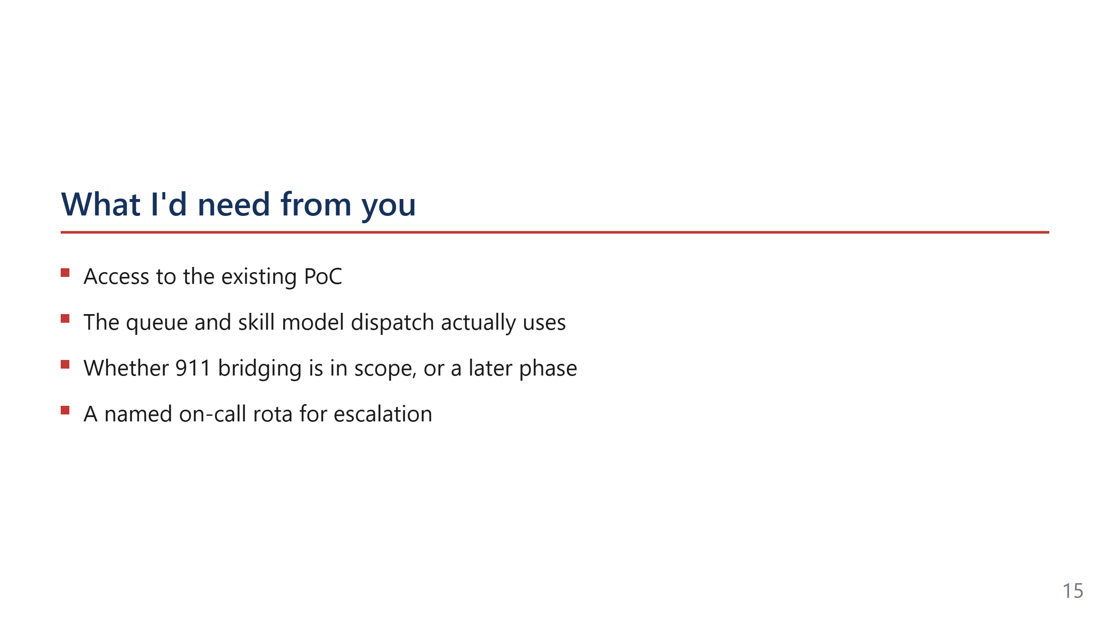
Notes:
These are the questions that show you've done this before. Ask them, then let the room
answer. Don't fill the silence.

Slide 16
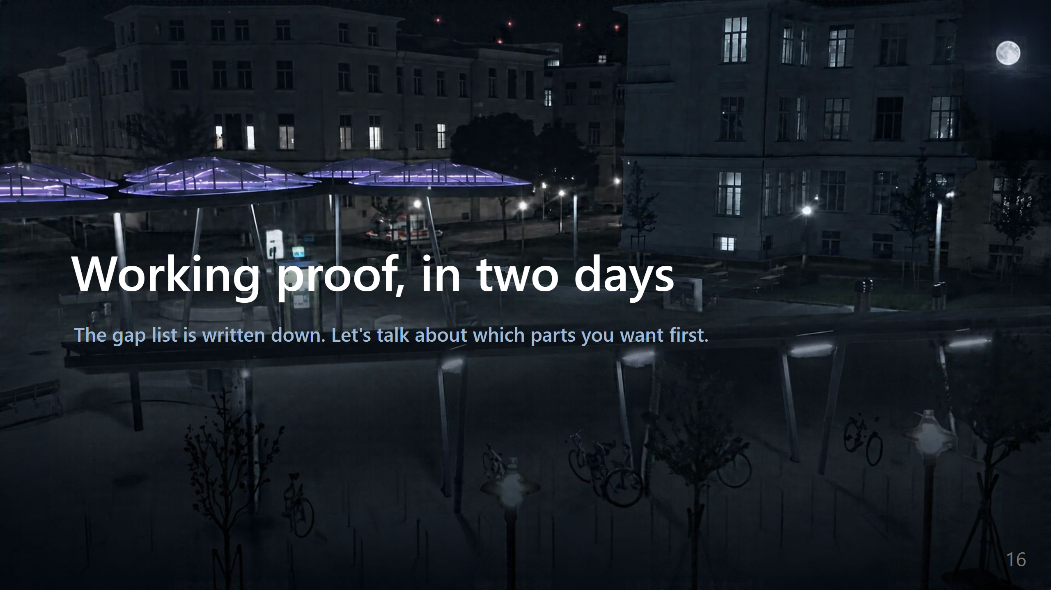
Notes:
_backgroundOpacity: 0.45
Stop talking after this. Let them ask. The deck has already made the argument; the close
is just the pause before questions.

